Slide 1
“Hey Batter,
Hey Batter,
Swing!”
EXODUS
32:1-29

Slide 2
EXODUS 20:18-21
18. Now all the people witnessed the thunderings, the lightning flashes, the sound of the trumpet, and the mountain smoking; and when the people saw it, they trembled and stood afar off.

Slide 3
EXODUS 20:18-21
19. Then they said to Moses, “You speak with us, and we will hear; but let not God speak with us, lest we die.”

Slide 4
EXODUS 20:18-21
20. And Moses said to the people, “Do not fear; for God has come to test you, and that His fear may be before you, so that you may not sin.”

Slide 5
EXODUS 20:18-21
21. So the people stood afar off, but Moses drew near the thick darkness where God was.

Slide 6
EXODUS 32:1
1. Now when the people saw that Moses delayed coming down from the mountain, the people gathered together to Aaron, and said to him, “Come, make us gods that shall go before us; for as for this Moses, the man who brought us up out of the land of Egypt, we do not know what has become of him.”

Slide 9
EXODUS 32:2-6
2. And Aaron said to them, “Break off the golden earrings which are in the ears of your wives, your sons, and your daughters, and bring them to me.”

Slide 10
EXODUS 32:2-6
3. So all the people broke off the golden earrings which were in their ears, and brought them to Aaron.

Slide 11
EXODUS 32:2-6
4. And he received the gold from their hand, and he fashioned it with an engraving tool, and made a molded calf. Then they said, “This is your god, O Israel, that brought you out of the land
of Egypt!”

Slide 12
EXODUS 32:2-6
5. So when Aaron saw it, he built an altar before it. And Aaron made a proclamation and said, “Tomorrow is a feast to the Lord.”

Slide 13
EXODUS 32:2-6
6. Then they rose early on the next day, offered burnt offerings, and brought peace offerings; and the people sat down to eat and drink, and rose up to play.

Slide 14
EXODUS 32:7-8
7. And the Lord said to Moses, “Go, get down! For your people whom you brought out of the land of Egypt have corrupted themselves.

Slide 15
EXODUS 32:7-8
8. They have turned aside quickly out of the way which I commanded them. They have made themselves a molded calf, and worshiped it and sacrificed to it, and said, ‘This is your god, O Israel, that brought you out of the land of Egypt!’”

Slide 16
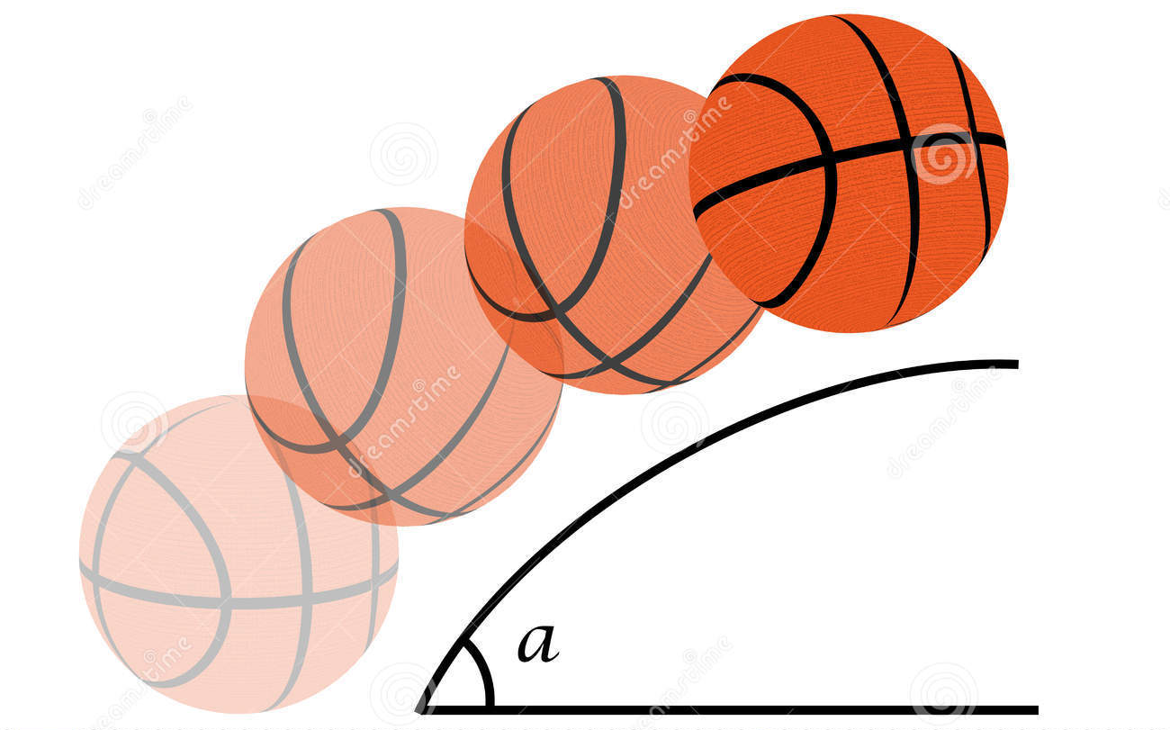

Slide 17
EXODUS 32:9
9. And the Lord said to Moses,
“I have seen this people,
and indeed it is a stiff-necked people!

Slide 18
NEHEMIAH 9:29
29. And testified against them, that You might bring them back to Your law. Yet they acted proudly, and did not heed Your commandments, but sinned against Your judgments, ‘Which if a man does, he shall live by them.’ And they shrugged their shoulders, stiffened their necks, and would not hear.

Slide 19
JEREMIAH 7:23
23. But this is what I commanded them, saying, ‘Obey My voice, and I will be your God, and you shall be My people. And walk in all the ways that I have commanded you, that it may be well with you.’

Slide 20
ACTS 7:51
51. “You stiff-necked and uncircumcised in heart and ears! You always resist the Holy Spirit; as your fathers did, so do you.

Slide 21
PROVERBS 29:1
1. He who is often rebuked, and hardens his neck, will suddenly be destroyed, and that without remedy.

Slide 22
EXODUS 32:10-24
10. Now therefore, let Me alone, that My wrath may burn hot against them and I may consume them. And I will make of you a great nation.”

Slide 23
EXODUS 32:10-24
11. Then Moses pleaded with the Lord his God, and said: “Lord, why does Your wrath burn hot against Your people whom You have brought out of the land of Egypt with great power and with a mighty hand?

Slide 24
EXODUS 32:10-24
12. Why should the Egyptians speak, and say, ‘He brought them out to harm them, to kill them in the mountains, and to consume them from the face of the earth’? Turn from Your fierce wrath, and relent from this harm to Your people.

Slide 25
EXODUS 32:10-24
13. Remember Abraham, Isaac, and Israel, Your servants, to whom You swore by Your own self, and said to them, ‘I will multiply your descendants as the stars of heaven; and all this land that I have spoken of I give to your descendants, and they shall inherit it forever.’”

Slide 26
EXODUS 32:10-24
14. So the Lord relented from the harm which He said He would do to His people.

Slide 27
EXODUS 32:10-24
15. And Moses turned and went down from the mountain, and the two tablets of the Testimony were in his hand. The tablets were written on both sides; on the one side and on the other they were written.

Slide 28
EXODUS 32:10-24
16. Now the tablets were the work of God, and the writing was the writing of God engraved on the tablets.

Slide 29
EXODUS 32:10-24
17. And when Joshua heard the noise of the people as they shouted, he said to Moses, “There is a noise of war in
the camp.”

Slide 30
EXODUS 32:10-24
18. But he said: “It is not the noise of the shout of victory, nor the noise of the cry of defeat, but the sound of singing I hear.”

Slide 31
EXODUS 32:10-24
19. So it was, as soon as he came near the camp, that he saw the calf and the dancing. So Moses’ anger became hot, and he cast the tablets out of his hands and broke them at the foot of the mountain.

Slide 32
EXODUS 32:10-24
20. Then he took the calf which they had made, burned it in the fire, and ground it to powder; and he scattered it on the water and made the children of Israel drink it.

Slide 33
EXODUS 32:10-24
21. And Moses said to Aaron, “What did this people do to you that you have brought so great a sin upon them?”

Slide 34
EXODUS 32:10-24
22. So Aaron said, “Do not let the anger of my lord become hot. You know the people, that they are set on evil.

Slide 35
EXODUS 32:10-24
23. For they said to me, ‘Make us gods that shall go before us; as for this Moses, the man who brought us out of the land of Egypt, we do not know what has become of him.’

Slide 36
EXODUS 32:10-24
24. And I said to them, ‘Whoever has any gold, let them break it off.’ So they gave it to me, and I cast it into the fire, and this calf came out.”

Slide 37
1 JOHN 1:9
9. If we confess our sins, He is faithful and just to forgive us our sins and to cleanse us from all unrighteousness.

Slide 38
EXODUS 32:25-26
25. Now when Moses saw that the people were unrestrained (for Aaron had not restrained them, to their shame among their enemies),

Slide 39
EXODUS 32:25-26
26. then Moses stood in the entrance of the camp, and said, “Whoever is on the Lord’s side—come to me!” And all the sons of Levi gathered themselves together to him.

Slide 41
EXODUS 32:29
29. Then Moses said, “Consecrate yourselves today to the Lord, that He may bestow on you a blessing this day, for every man has opposed his son and his brother.”

Slide 44
“Hey Batter,
Hey Batter,
Swing!”
EXODUS
32:1-29

